Slide 1
Structure Programming
ICT-1105
Information and Communication Technology
Lecture-02

Slide 2
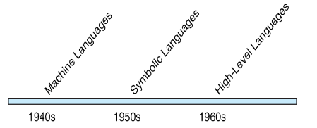
Computer Languages
In order to communicate with the computer user also needs to have a language that should be understood by the computer. For this purpose, different languages are developed for performing different types of work on the computer.

Slide 3
Computer Languages
Basically, languages are divided into two categories according to their interpretation.
1. Low Level Languages.
2. High Level Languages.

Slide 4
Computer Languages
Low Level Languages:
Low level computer languages are machine codes or close to it. Computer cannot understand instructions given in high level languages or in English. It can only understand and execute instructions given in the form of machine language i.e. language of 0 and 1.
There are two types of low level languages:
Machine Language.
Assembly Language

Slide 5
Computer Languages
Machine Language: It is the lowest and most elementary level of Programming language and was the first type of programming language to be Developed. Machine Language is basically the only language which computer Can understand. In fact, a manufacturer designs a computer to obey just one Language, its machine code, which is represented inside the computer by a String of binary digits (bits) 0 and 1. The symbol 0 stands for the absence of Electric pulse and 1 for the presence of an electric pulse . Since a computer is Capable of recognizing electric signals, therefore, it understand machine Language.

Slide 6
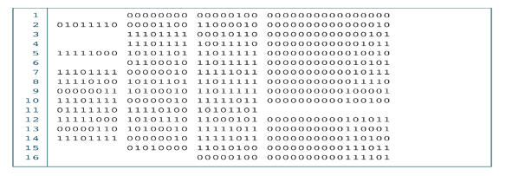
Computer Languages

Slide 7
Computer Languages
Advantages of Machine Language:
i) It makes fast and efficient use of the computer.
ii) It requires no translator to translate the code i.e. Directly understood by the computer
Disadvantages of Machine Language:
i) All operation codes have to be remembered.
ii) These languages are machine dependent i.e. a particular Machine language can be used on only one type of computer
iii) It is difficult to learn and even more difficult to write programs.

Slide 8
Computer Languages
Assembly Language:
It was developed to overcome some of the many inconveniences of machine language. This is another low level but a very important language in which operation codes and operands are given in the form of alphanumeric symbols instead of 0’s and l’s. These alphanumeric symbols will be known as mnemonic codes and can have maximum up to 5 letter combination e.g. ADD for addition, SUB for subtraction, START,LABEL etc. Because of this feature it is also known as “Symbolic Programming Language”. This language is also very difficult and needs a lot of practice to master it because very small English support is given to this language. The language mainly helps in compiler orientations. The instructions of the Assembly language will also be converted to machine codes by language translator to be executed by the computer.

Slide 9
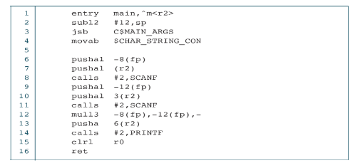
Computer Languages
Assembly Language:

Slide 10
Computer Languages
Advantages of Assembly Language:
i) It is easier to understand and use as compared to machine language.
ii)It is easy to locate and correct errors.
iii) It is modified easily
Disadvantages of Assembly Language:
i) Like machine language it is also machine dependent.
ii) Since it is machine dependent therefore programmer Should have the knowledge of the hardware also.

Slide 11
Computer Languages
High Level Languages:
High level computer languages give formats close to English language and the purpose of developing high level languages is to enable people to write programs easily and in their own native language environment (English). High-level languages are basically symbolic languages that use English words and/or mathematical symbols rather than mnemonic codes. Each instruction in the high level language is translated into many machine language instructions thus showing one-to-many translation

Slide 12
Computer Languages
Types of High Level Languages:
Many languages have been developed for achieving different variety of tasks, some are fairly specialized others are quite general purpose.
These are categorized according to their use as
a) Algebraic Formula-Type Processing: These languages are oriented towards the computational procedures for solving mathematical and statistical problem. Examples are
BASIC (Beginners All Purpose Symbolic Instruction Code).
FORTRAN (Formula Translation).
PL/I (Programming Language, Version 1).
ALGOL (Algorithmic Language).
APL (A Programming Language).

Slide 13
Computer Languages
Types of High Level Languages:
b) Business Data Processing:
These languages emphasize their capabilities for maintaining data processing procedures and files handling problems.
Examples are:
COBOL (Common Business Oriented Language).
RPG (Report Program Generator).

Slide 14
Computer Languages
Types of High Level Languages:
C) String and List Processing:
These are used for string manipulation including search for patterns, inserting and deleting characters.
Examples are:
LISP (List Processing).
Prolog (Program in Logic).

Slide 15
Computer Languages
Types of High Level Languages:
d) Object Oriented Programming Language:
In OOP, the computer program is divided into objects.
Examples are:
C++
Java

Slide 16
Computer Languages
Types of High Level Languages:
e) Visual programming language:
These are designed for building Windows-based applications.
Examples are:
Visual Basic
Visual Java
Visual C

Slide 17
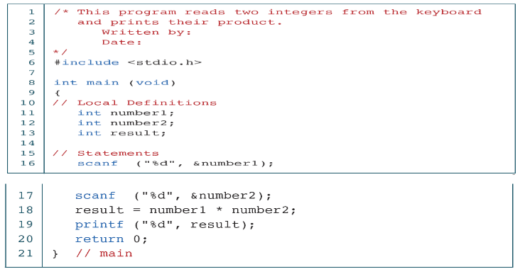
Computer Languages

Slide 18
Computer Languages
Advantages of High Level Language:
User-friendly
Similar to English with vocabulary of words and symbols
Therefore it is easier to learn.
They are easier to maintain.

Slide 19
Computer Languages
Disadvantages of High Level Language:
A high-level language has to be translated into the machine language by a translator and thus a price in computer time is paid.
The object code generated by a translator might be inefficient Compared to an equivalent assembly language program.

Slide 20
PROGRAMMING LANGUAGE TRANSLATORS
High level language is machine independent and assembly language though it is machine dependent yet mnemonics that are being used to represent instructions are not directly understandable by the machine. Hence to make the machine understand the instructions provided by both the languages, programming language instructors are used. They transform the instruction prepared by programmers into a form which can be interpreted & executed by the computer.

Slide 21
PROGRAMMING LANGUAGE TRANSLATORS
Compiler:
The software that reads a program written in high level language and translates it into an equivalent program in machine language is called as compiler. The program written by the programmer in high level language is called source program and the program generated by the compiler after translation is called as object program.

Slide 22
PROGRAMMING LANGUAGE TRANSLATORS
Interpreter:
It also executes instructions written in a high level language. Both complier & interpreter have the same goal i.e. to convert high level language into binary instructions, but their method of execution is different. The complier converts the entire source code into machine level program, while the interpreter takes 1 statement, translates it, executes it & then again takes the next statement.

Slide 23
PROGRAMMING LANGUAGE TRANSLATORS
Assembler:
The software that reads a program written in assembly language and translates it into an equivalent program in machine language is called as assembler.

Slide 24
PROGRAMMING LANGUAGE TRANSLATORS
Linker:
A linker or link editor is a computer program that takes one or more object files generated by a compiler and combines them into a single executable file, library file, or another object file.

Slide 25
Thank you….

